Slide 1
UNIT 3 – CREATION OF HEALTHY and CARING RELATIONSHIPS
A Scientific approach to Health
AEC 26

Slide 2
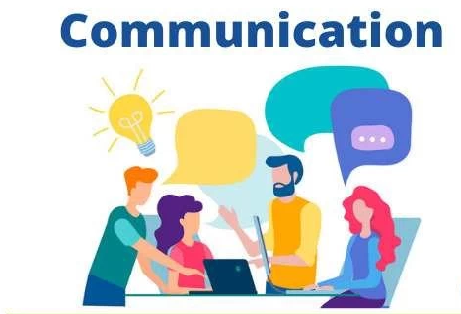
Building Communication Skills
Communication and its essence
Personal Process
Communication is the art of transmitting information, ideas and attitudes from one person to another.
Communication is the process of meaningful interaction among human beings.
Involves change in behavior
Means to influence others
Expression of thoughts and emotions through words & actions.
Tool for controlling and motivating people.
It is a social and emotional process.

Slide 3
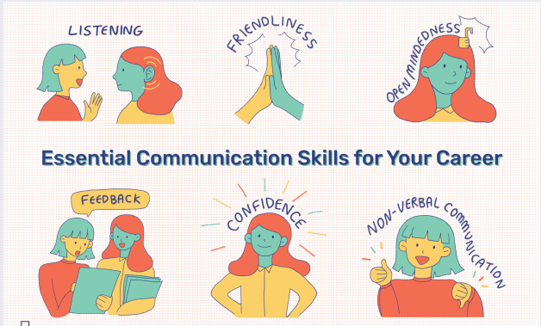
Building Communication Skills

Slide 4
Communication Process
Sender: The person who conceptualized the idea and wants it delivered to the recipient.
Encoding: The way the information is described or translated into a message.
Message: The idea, fact or opinion that the sender wants to communicate.
Communication channel: The method of delivering the message.
Noise or Distraction: Hinders successful communication.
Types : Psychological, Physical, Environmental and Semantic.
Receiver: The target audience of the message.
Decoding: The interpretation of the message.
Feedback: The response or action a receiver takes after decoding a message.

Slide 5
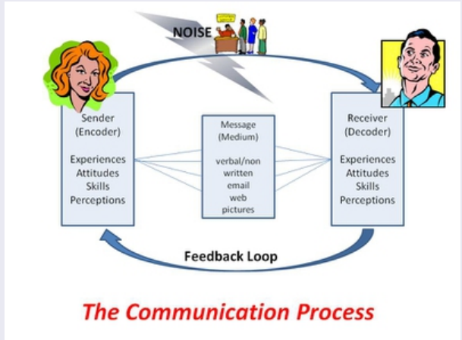
Communication Process

Slide 6
The 3 Important Rules of Communication
In any language, there are three extremely important points to remember when you’re communicating with someone.
Say what you mean. It can be difficult to express (say) some ideas clearly, but if you’re trying to prevent miscommunication, it’s important to say exactly what you mean. Be clear and to the point.
2. Ask questions. Communication is two-way, which means you can’t be the one doing all the talking. To make sure your listener is engaged (interested in what you have to say) and understanding you, ask questions. See #5 below for good types of questions to ask.
3. Listen. We mean really listen. Hear what your speaking partner has to say, and try to understand what they mean.

Slide 7
Barriers of Communication
Types of Barriers Psychological Barriers Physical Barriers Emotional Barriers Attitudinal Barriers Cultural Barriers Language Barriers Gender Barriers Interpersonal Barriers | No interest in the conversation. Jumping to conclusions without waiting for the whole message. Inability to Listen to Others. Lack of Transparency & Trust. Communication Styles (when they differ). Fear of offending the other person by expressing your opinions. Cultural Differences & Language. One feels not comfortable sharing your feelings with the other person

Slide 8
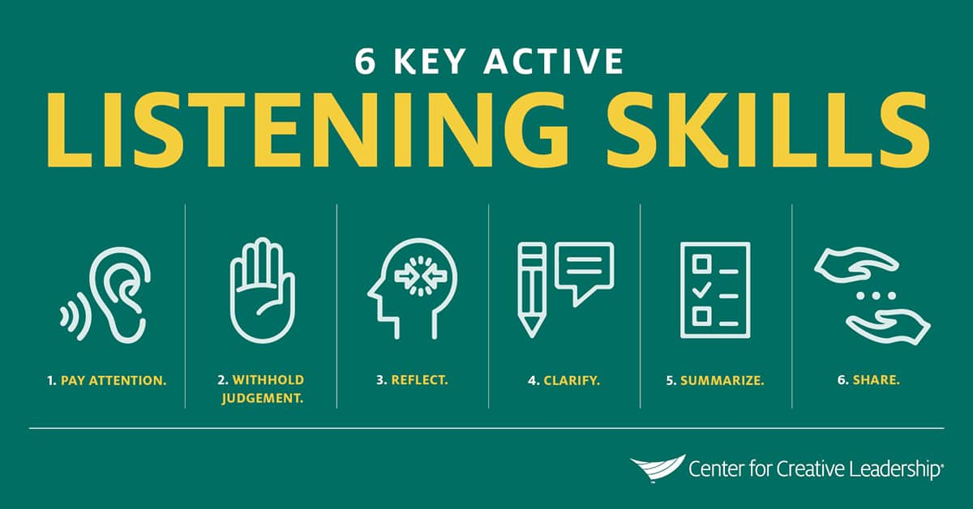
Listening

Slide 9
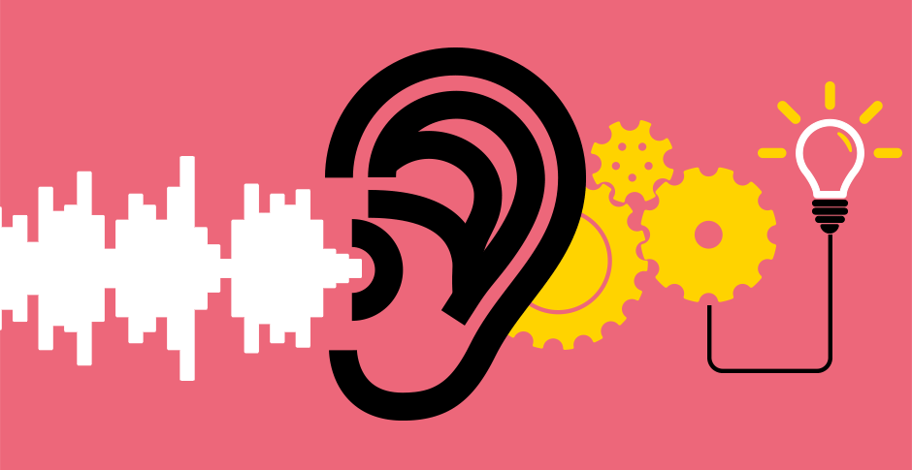
WAYS TO IMPROVE THE COMMUNICATION SKILLS :
1) Listen without judgment : The key to good communication is listening well. Save your judging for later after you have heard and understood what was said.
2) Listen with the willingness :
3) Listen without thinking about what you will say next.
4) Do not be invested in being right.
5) If your mind wanders, ask for repetition.
6) In all cases repeat back what you heard and ask if it is correct.
7) Listen to yourself.
8) Say it honestly, but with consideration for the listener's feelings. Be polite, respectful and sincere.
9) Understand and acknowledge that most things are not black or white, but somewhere in a gray area.
10) Have integrity and build trust. Don't say what you don't mean. Don't promise what you won't or can't fulfill. Follow through with any commitments you make.
11) Eye contact - Eye contact is also a big giveaway; making and maintaining eye contact is a big indicator of confidence.

Slide 10
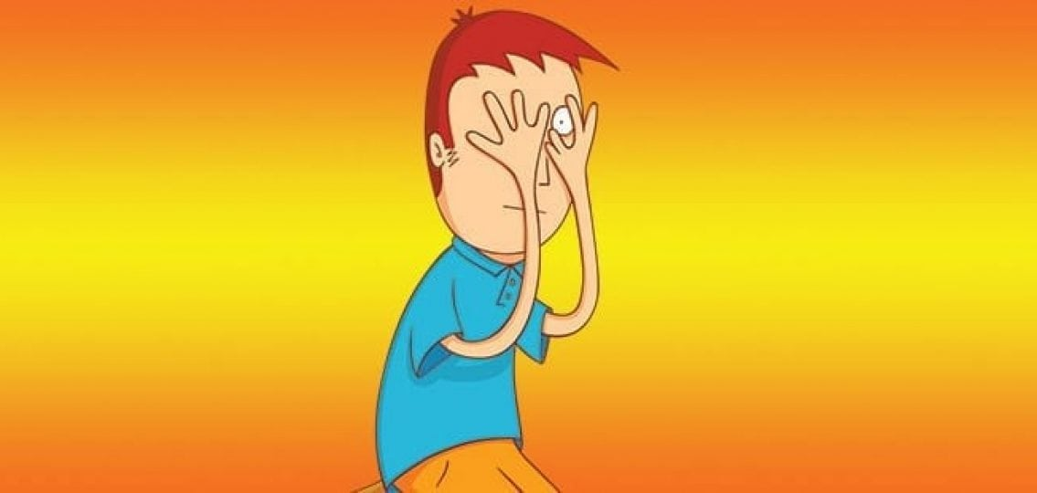
Steps to avoid embarrassing in communication with others:
1. Be patient Your ideas are important, but no more important than anyone else’s.
2 Listen carefully If you are busy thinking about what you want to say, you aren’t going to hear what the other person is saying.
3. Take notes if necessary If the discussion is a long one, notes can help you remember the points you want to make.
4. Rephrase what was said in your own words This is the clearest way to esure you haven’t made an assumption about what a statement means.
5. Don’t interrupt The speaker may be going on to clarify exactly what you are questioning.
6. Pause and reflect : Allow some time to let the speaker’s comments fully sink in by pausing and reflecting before you jump in to speak.

Slide 11
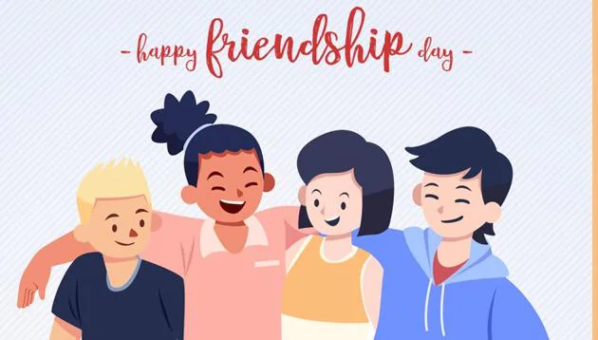
Friends and Friendship - Education
Friend : ”a person with whom one has a bond of
mutual affection, typically one exclusive of sexual or
family relations”
A person who has a strong liking for and trust in another person.
A person who helps or supports something She was a friend to environmental causes.
Friendship : ”Friendship is a relationship of mutual affection between people. It is a stronger form of interpersonal bond than an acquaintance or an
association, such as a classmate, neighbor, or colleague. ”
It is a dyadic relationship (Smallest Possible social group), meaning that it involves a series of interactions between two individuals known to each other.
It is recognized by both members of the relationship and is characterized by a bond or tie of reciprocated affection.
It is not obligatory; two individuals choose to form a friendship with each other.

Slide 12
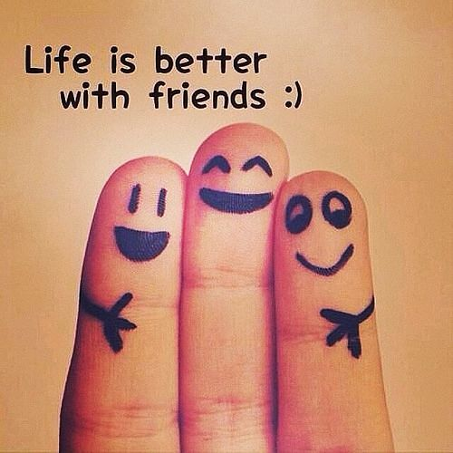
Friends and Friendship - Education
It is almost always characterized by companionship and shared activities.
One of the primary goals and motivations of friendship is companionship.
In addition, adolescent and adult friendships often perform other functions, such as serving as sources of emotional support and providing opportunities for self-disclosure and intimacy.

Slide 13
Qualities Of A True Friend” - A faithful friend is a sure anchor
Will always be honest with you.
Loves you for yourself and unconditional
Gives more than they take.
Compromises
Forgives you even without an apology.
Believe in you.
Make time for you.
Respectful to you.
Thoughtful.
Stick around you.

Slide 14
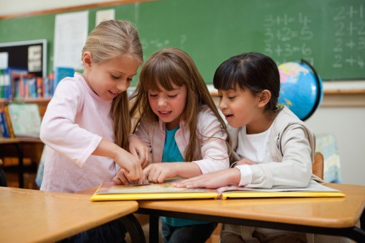
“Friendship in Education”
They provide support and resources and can both encourage and discourage academic achievement.
Contribute to a positive sense of mental well-being
Encourage learning and develop interpersonal skills
Play a significant role in promoting overall health.
Development of Social Skills
Better Cooperation
Better Problem solving abilities
Better Communication
Better Academic outcomes

Slide 15
The Value of Relationships and Communication
”WHY COMMUNICATION IS KEY TO HEALTHY RELATIONSHIPS”
Communication is important in any relationship, as it allows you to effectively share feelings, opinions and expectations.
GET TO KNOW EACH OTHER : The key to determining whether you’re compatible with another person is to communicate with them from the offset.
AVOID MISUNDERSTANDING : Another reason to communicate effectively is to avoid any misunderstandings, which can lead to a breakdown of communication or the relationship as a whole.
SET CLEAR EXPECTATIONS : In any relationship, it’s important that these expectations are made clear from the offset, to avoid one party upsetting the other without realizing. Always be open and honest and never be afraid to stand by what you believe in. Thus healthy, positive and satisfying relationship.

Slide 16
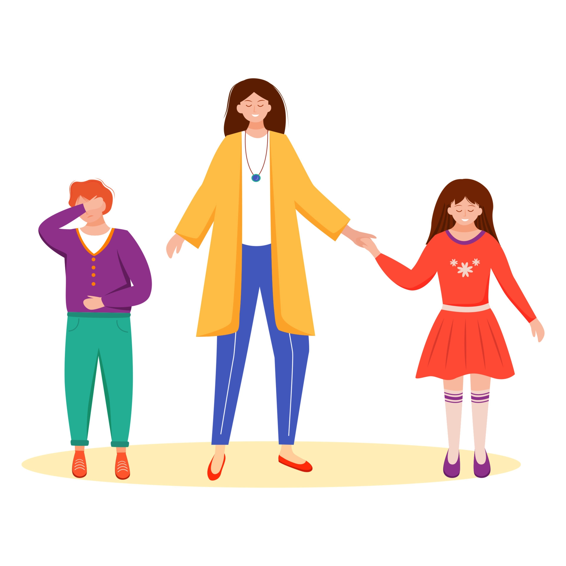
”HOW TO IMPROVE COMMUNICATION IN A RELATIONSHIP”
Always talk about important or sensitive issues face-to-face.
Be open and honest.
Find the right time for important conversations.
Don’t be abusive or verbally aggressive, even if it’s an emotive issue.
Approach conversations in a calm and relaxed way, in a quiet environment where both parties are comfortable.
Use positive body language.
Choose your language carefully.

Slide 17
EXAMPLES OF GOOD COMMUNICATION IN RELATIONSHIPS
Giving your partner, friend or family member your full attention.
Giving each other space when needed.
Face-to-face communication.
Honesty and openness.
24- hour rule – never sleep on an argument.
Talk about the little things in life.

Slide 18
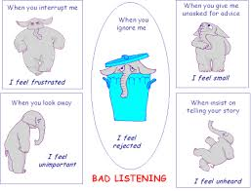
”EXAMPLES OF BAD COMMUNICATION IN RELATIONSHIPS”
Belittling each other Openly giving the cold shoulder
Becoming defensive in heated discussions
Assuming you know what the other person is thinking
Arguments that are never resolved and brushed under the carpet
Inability to compromise
Few attempts to connect

Slide 19
Relationships for Better or Worsening of Life
Satisfying relationships not only make us happy, they also influence our long-term health as much as getting enough sleep, eating healthy, and not smoking.
Many research studies have shown that satisfying relationships are associated with better health, greater happiness, and even longer life.
Stronger Heart and Healthier Brain
An unhealthy relationship will cause lot of stress, loneliness and will make us an irritable person which will work as a retarding force in our way of achieving success.
While in an unhealthy relationship we lose trust on each other and respect for each other decreases.
A research shows that a healthy relationship have 5 to 1 ratio of positive to negative behaviors and a unhealthy relationship have a much lower ratio of positive to negative behaviors.

Slide 20
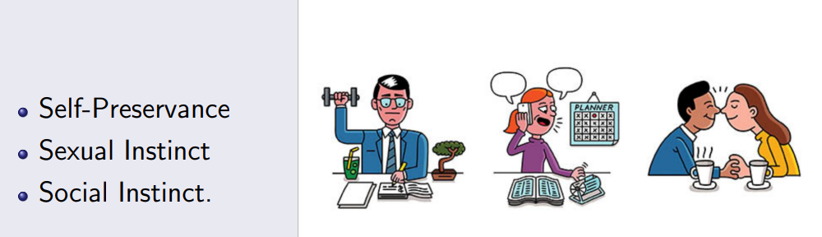
Understanding Basic Instincts of Life (More than a Biology)
”Three Basis instincts of Human Life”

Slide 21
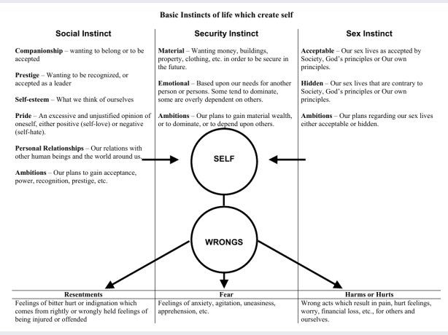

Slide 22
Changing Health Behaviors Through Social Engineering
Modifying the environment in ways that affect people’s ability to practice a particular health behavior –
Banning certain drugs such as heroin and cocaine
Requiring vaccinations for school entry
Using safety containers for medications
Lowering speed limits
Raising the drinking age

Slide 23
Changing Health Behaviors Through Social Engineering
Venues for health habit modification
Private therapist’s office
Health practitioner’s office
Family
Self-help groups
Schools and colleges
Workplace interventions
Community-based interventions
Mass media such as newspaper and magazine articles, published photographs, recordings of television and radio broadcasts, music recorded for mass distribution, advertisements, books
Cellular phones and landlines
Internet

